Slide 1
ONLINE POLLING SYSTEM
Presented by,
Yokesh Balasubramanian

Slide 2
TABLE OF CONTENTS
About cmot
Project requirements
Use cases
Technologies used
Application Flow
My contributions

Slide 3
CMOT
Reconciliation
Volker aggregator
Ocean
Trade surveillance
User Experience Team

Slide 4
REQUIREMENTS
To build an online polling system to enable various users to participate in polls and surveys for research purposes
Pages to add/modify/delete polls/questions/options
Capture the result of all the polls
Java service to integrate all functionalities
Data layer
Login management

Slide 5
Use Case
Strengthen customer relationships
Discover new product or services.
Gauge your marketing efforts
Analyze and track customer insights
Evaluate employee satisfaction
Get feedback on meeting, training, and events

Slide 6
ROLES
ROLES
ADMIN
POLLMASTER
USER
FUNCTIONALITIES:
Add category
Edit category
Add question
Edit question
Delete question
Delete category
Edit role of users
Assign poll masters
Activate/Deactivate polls
View all results
FUNCTIONALITIES:
Edit category
Add question
Edit question
Delete question
Attend polls like user
View results for attended and assigned polls
FUNCTIONALITIES:
Attend active polls
View Result for the polls he has taken

Slide 7
ADMIN
LOGIN
VIEW POLLS
VIEW RESULTS
LOGOUT
ADD POLLS
EDIT POLLS
DELETE POLLS
ENABLE/DISABLE POLLS
SET ROLES
ASSIGN POLLMASTERS

Slide 8
POLL MASTER
POLL MASTER
VIEW POLLS
EDIT POLLS
VIEW RESULTS
SIGN-UP/
LOGIN
LOGOUT
USER FUNCTIONALITIES

Slide 9
USER
SIGN-UP/
LOGIN
VIEW POLLS
TAKE POLL
NO
SUBMIT POLL
SAVE?
YES
VIEW RESULTS
LOGOUT

Slide 10
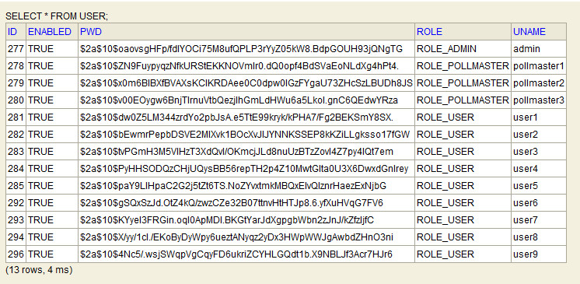
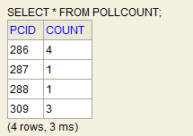
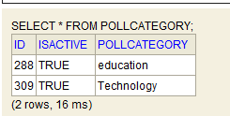
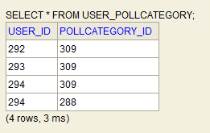
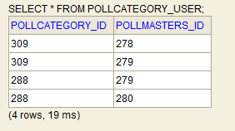
DB VIEW
n
n
1
1
FOLLOWING ARE THE ASSOCIATION TABLES CREATED :

Slide 11
TECHNOLOGIES USED
IDE | ECLIPSE
FRONTEND | BOOTSTRAP
BACKEND | SPRING MVC
SERVER | TOMCAT
DATABASE | H2
BUILD TOOL | MAVEN
TESTING | JUNIT

Slide 12
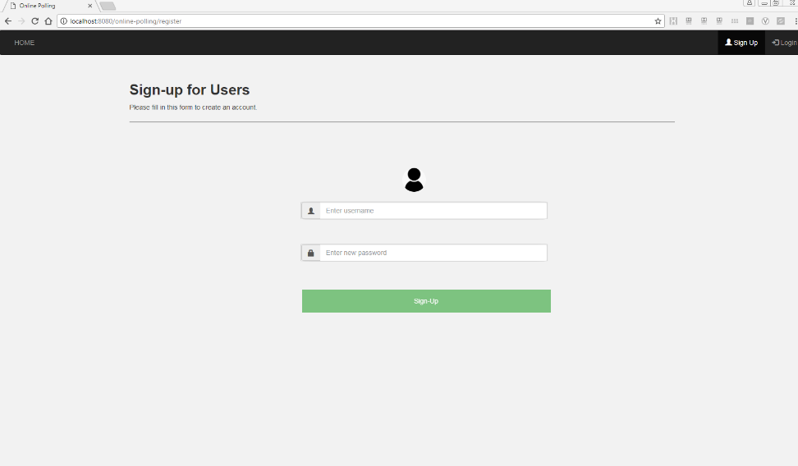
SIGNUP
Username validation
Password Validation
Password Hashing
Displaying appropriate pop up messages.
Concepts Used:
BCryptPasswordEncoder
HibernateValidator
Hibernate Query
Learnt:
Storing passwords securely

Slide 13
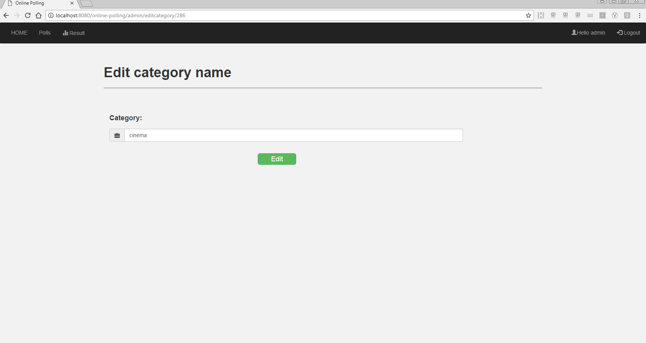
EDIT CATEGORY NAME
Only Admin is allowed the edit the name of the poll category.
Prevents duplicate Category name.
Concepts Used:
Hibernate Validator

Slide 14
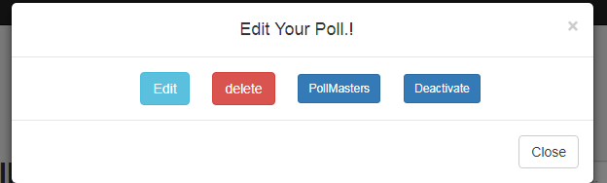
DELETE A CATEGORY
Only admin is allowed to delete the category.
Delete the category with questions.
Delete assigned pollmaster.
Delete from attended poll list.
Concepts used:
One to one Mapping
Hibernate Query
Learnt:
Hibernate Mapping

Slide 15
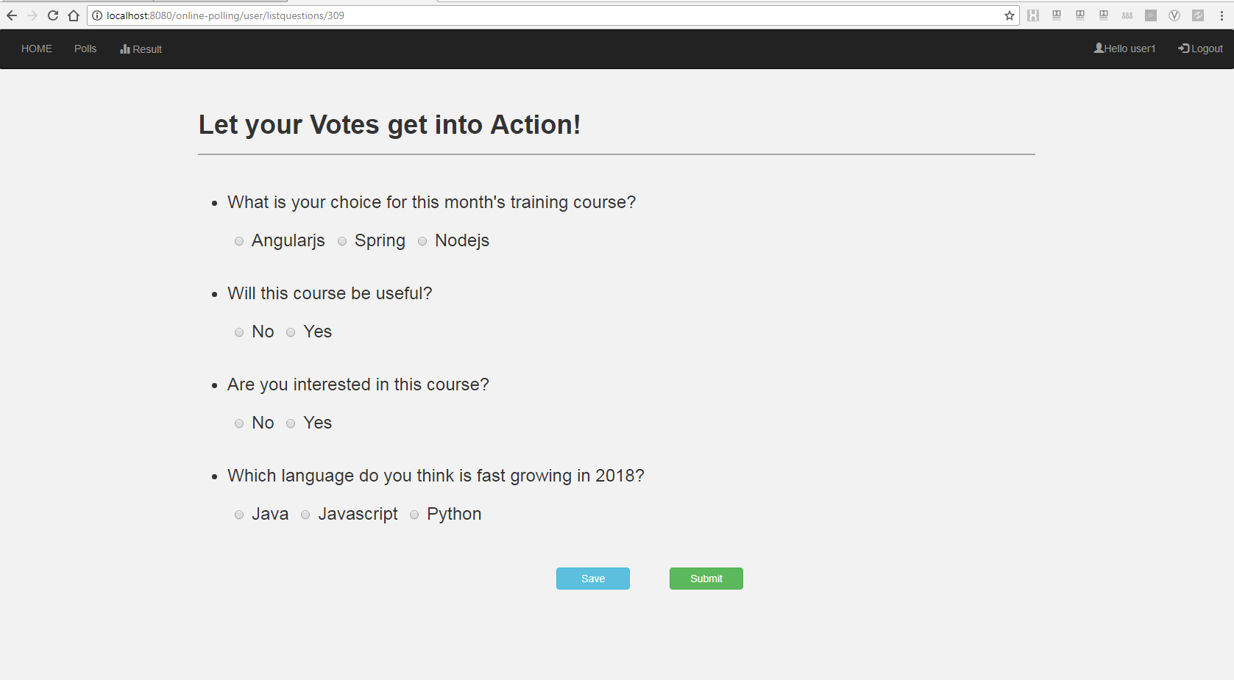
SAVING POLL
Used to save the poll for reusing it later.
Concepts used:
Map
GSON Library
Learnt:
Session Storage
Local Storage
Map to JSON Conversion

Slide 16
RESULT PAGE CUSTOMIZATION
ROLES | POLLS WITH POLLCOUNT
USER | ATTENDED POLLS
POLLMASTER | ATTENDED POLLS AND ASSIGNED POLLS
ADMIN | ALL THE POLLS
Concepts used:
Fetching polls according to user id and role-DB
Displaying appropriate popup messages

Slide 17
PREVENTING BACKWARD FLOW
Prevents the user to go backward using browser back button once he logs outs.
Concepts used:
Logout success URL
Deleting cookies through JSESSIONID
Learnt:
Session maintenance

Slide 18
LOG ERROR
Displaying appropriate error message by rendering error.jsp.
CONCEPTS USED:
LOG4J
CommonsLogging
Learnt:
Different modes for logging error
How logging happens in real time web apps!

